Slide 1
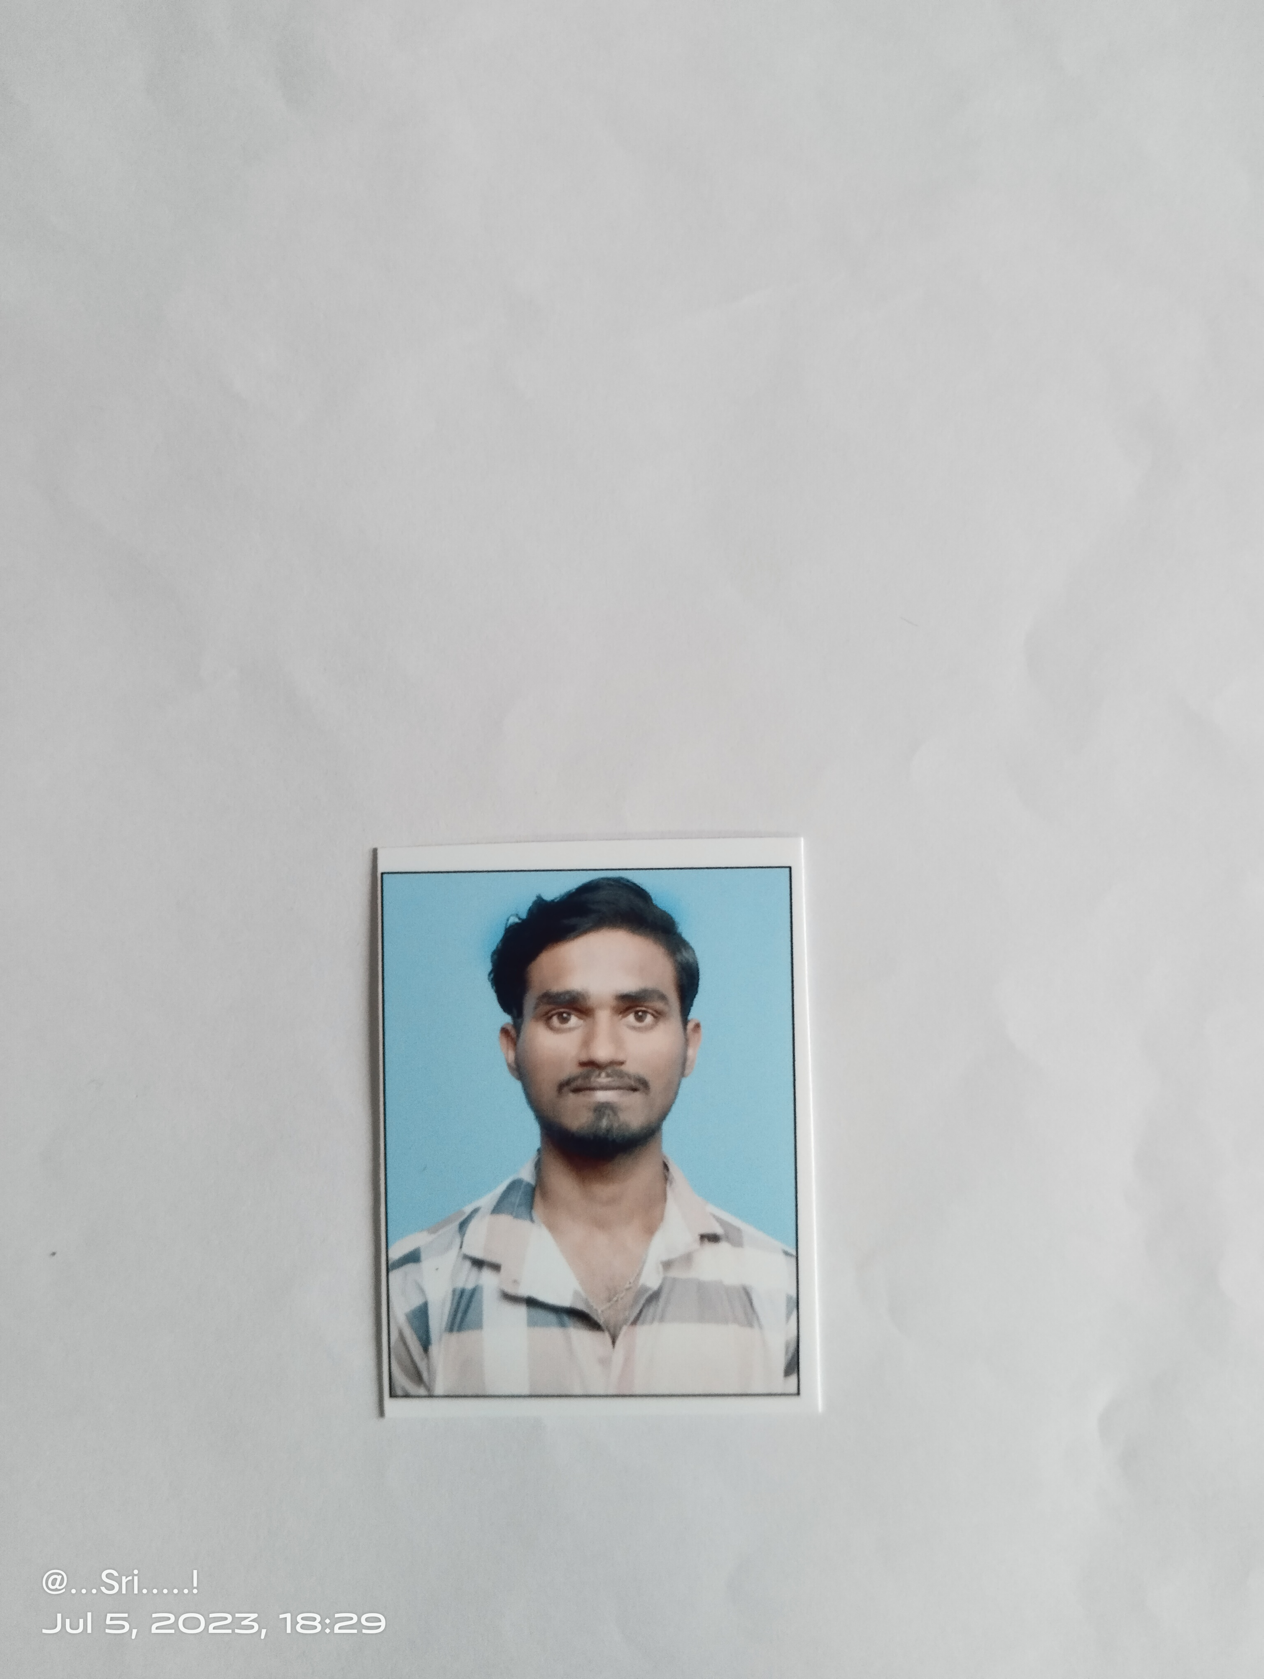
Student Details Name : Srikanth Jammula SkillsBuild Email ID : srikanthjam21@gmail.com College Name : Madanapalli Institute of Technology and Science
College State : Andhra Pradesh Internship Domain & Internship Start & End date : Artificial Intelligence & 12-June-2023 to 17-July-2023

Slide 2

Ai mental fitness tracker

Slide 3
AGENDA
Import required libraries
Explore data
Merge the two data sets
Data cleaning
Data visualization
Split data
Model training
Linear Regression

Slide 4
PROJECT OVERVIEW
Designed to help veterans,reservists and other service members better understand and boost their mental fitness and overall well-being.
It can predict with 70 to 80% accuracy whether someone is at risk of having a mental disorder and helps them find the appropriate help.

Slide 5
WHO ARE THE END USERS of this project?
Individuals: Mental fitness trackers can be designed for individual users who are interested in monitoring and improving their mental well-being. These individuals may be seeking ways to track their mood, stress levels, sleep patterns, or other psychological factors.
Mental Health Professionals: Mental fitness trackers can be utilized by mental health professionals, such as psychologists, therapists, or counselors.
Corporate Organizations: Some mental fitness trackers may be aimed at the corporate sector, where employers provide them to their employees as a part of workplace wellness programs.
Researchers: Mental fitness trackers can be used by researchers in the field of psychology or mental health to gather data and conduct studies.
Educational Institutions: Mental fitness trackers can also be used in educational settings, such as schools or universities, to help students monitor their mental well-being and provide resources for stress management, mindfulness, or other mental health interventions.

Slide 6
SOLUTION AND ITS VALUE PROPOSITION
Personalized Support: Our AI mental fitness tracker analyzes user data. By understanding individual needs, it offers tailored support that addresses specific mental health concerns and promotes overall well-being.
Early Detection and Prevention: Through advanced AI algorithms, our tracker can identify patterns and anomalies in user data, enabling early detection of potential mental health issues. our solution helps prevent the escalation of mental health problems, improving outcomes and reducing suffering.
Personalized Interventions: Leveraging AI capabilities, our tracker offers personalized interventions based on individual needs. Whether it's guided meditation exercises, stress reduction techniques, or cognitive behavioral therapy exercises, our solution provides users with effective tools and strategies to address their specific challenges, enhancing their mental well-being.
The value our AI mental fitness tracker brings is multifaceted. It empowers individuals to take control of their mental health by offering personalized support and interventions. It helps in the early detection and prevention of mental health issues, potentially saving lives and reducing healthcare costs.

Slide 7
project customizATION
Importing required libraries like numpy,pandas,seaborn,matplotlib & pyplot,plotly.express
Loading the data by copying the path of file & Exploring data.
Merging the two data sets & Data cleaning.
Data visualization through heatmap,pairplot & piechart.
Splitting data and Model training.
Linear Regression Algorithm.

Slide 8
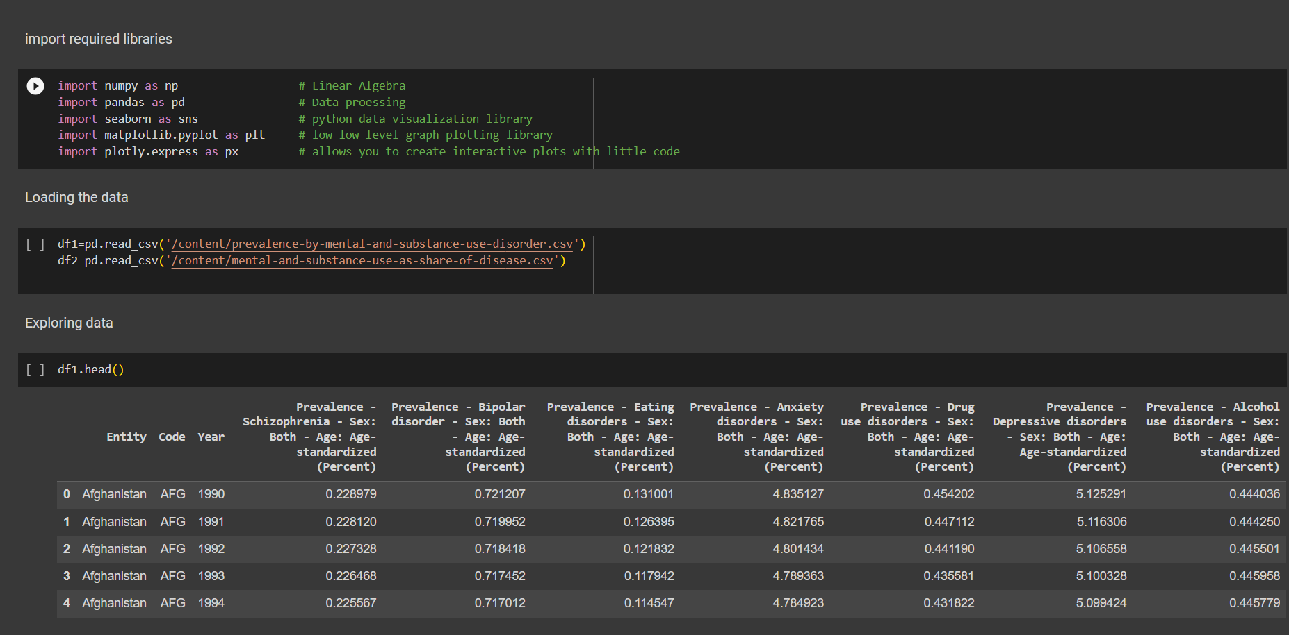
MODELLING

Slide 9
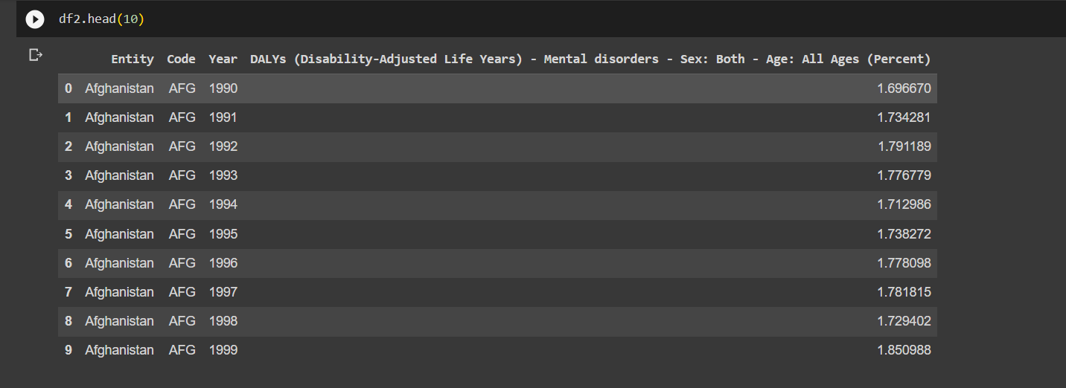

Slide 10
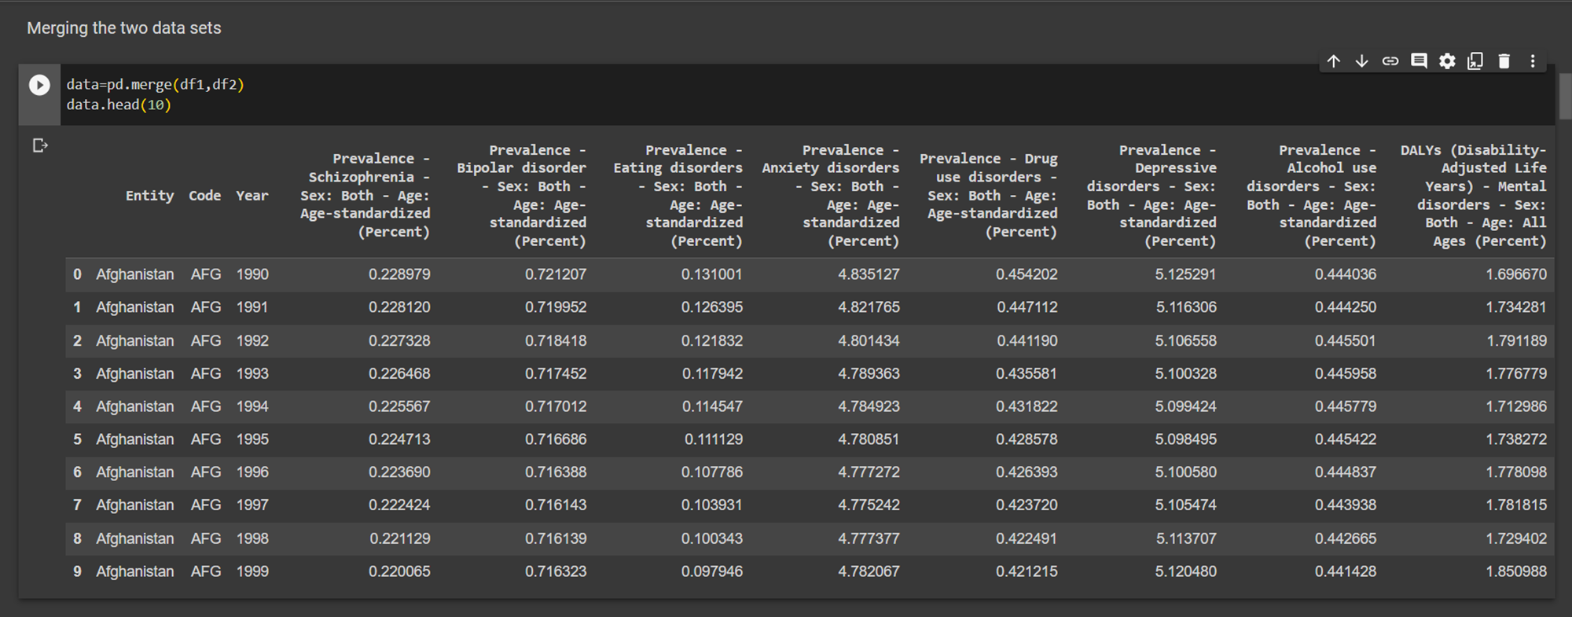
MODELLING

Slide 11
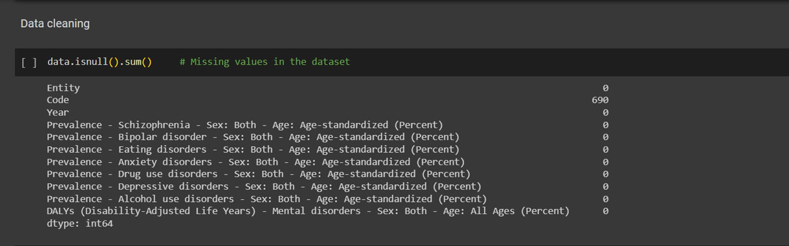
MODELLING

Slide 12
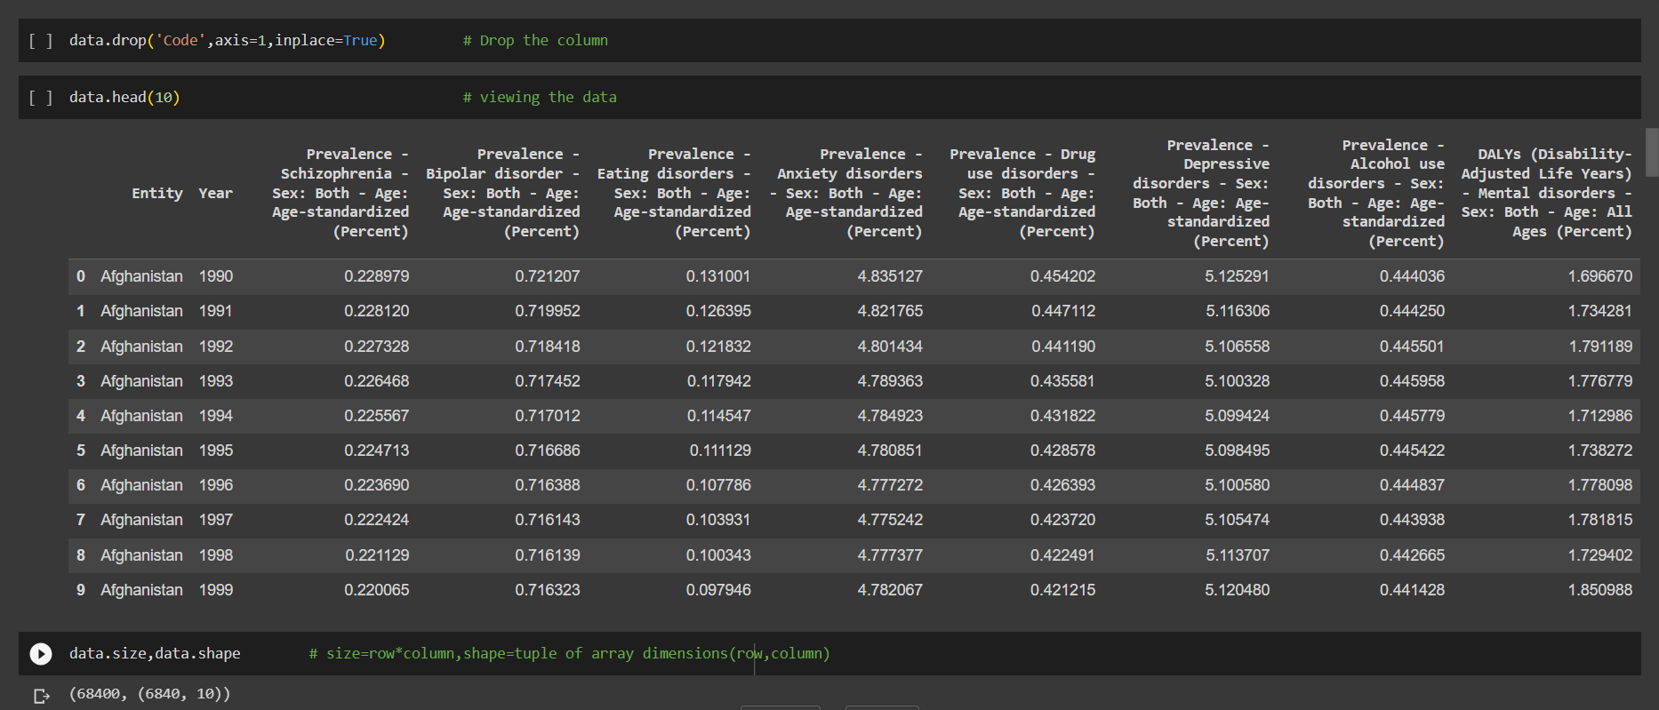
MODELLING

Slide 13
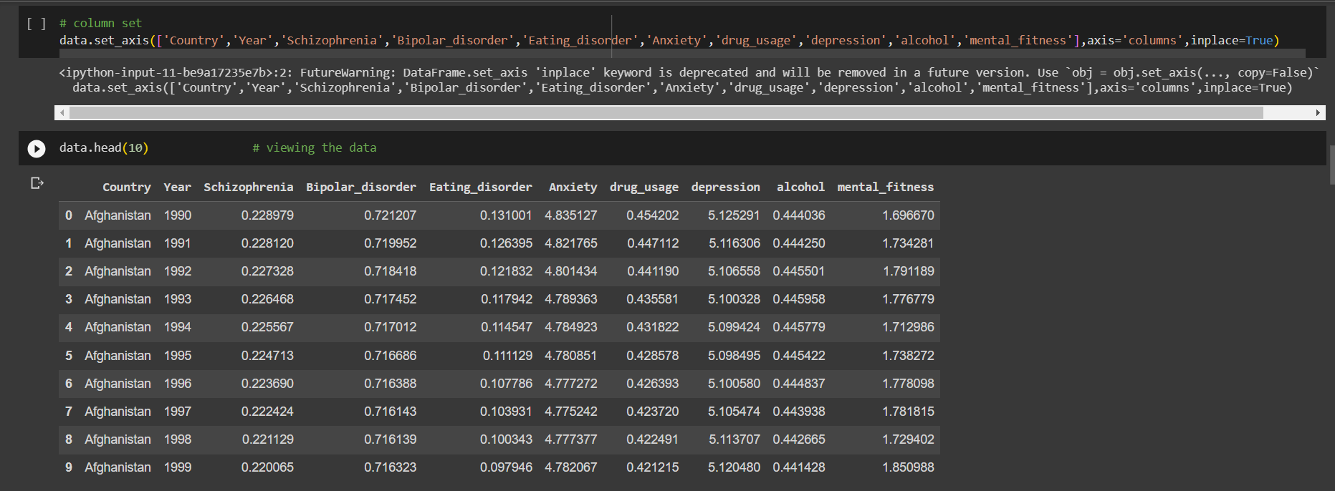
MODELLING

Slide 14
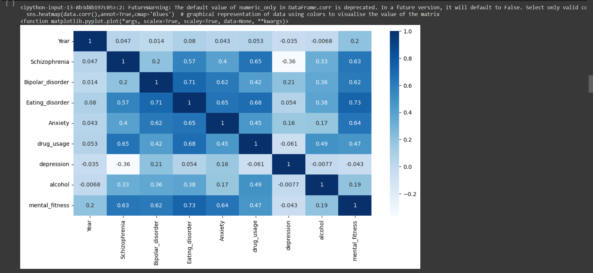
MODELLING

Slide 15
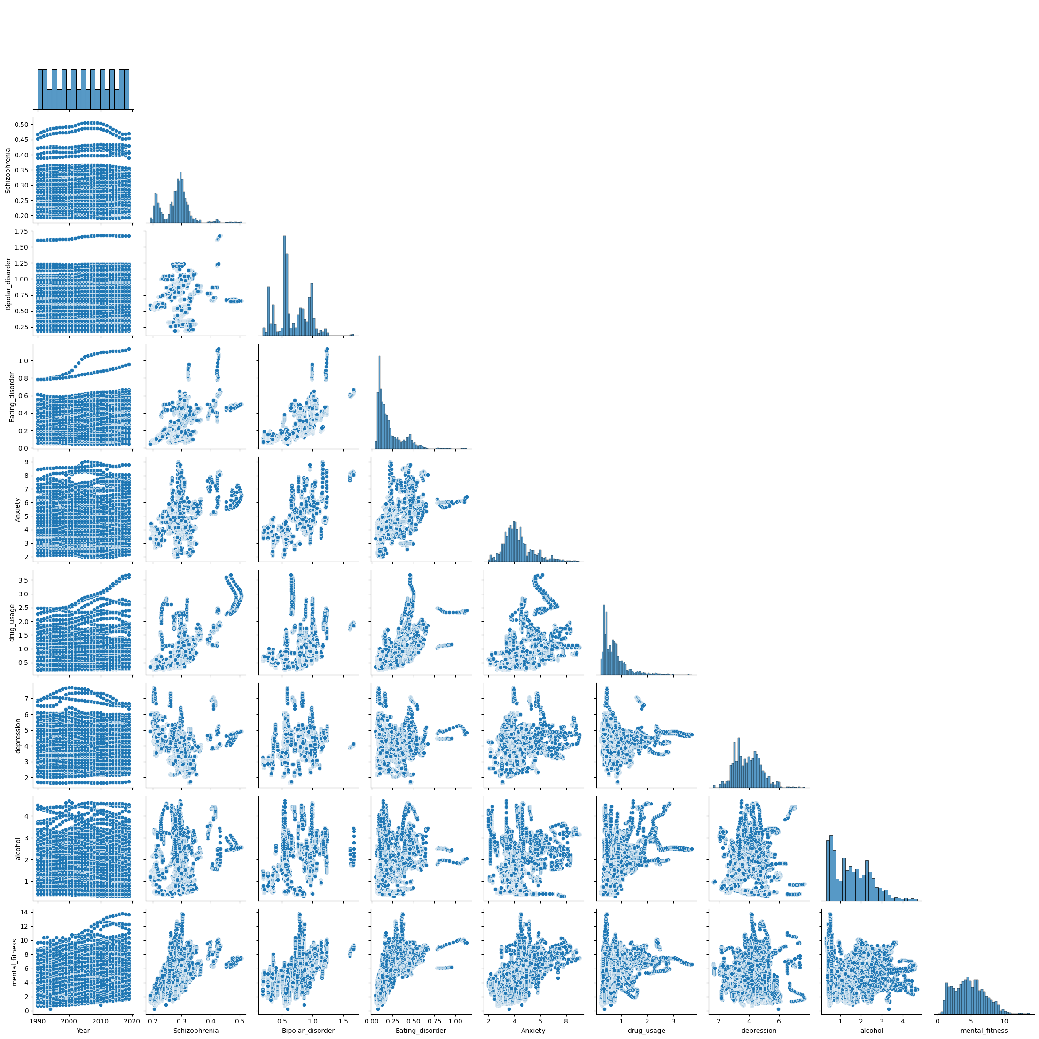

Slide 16
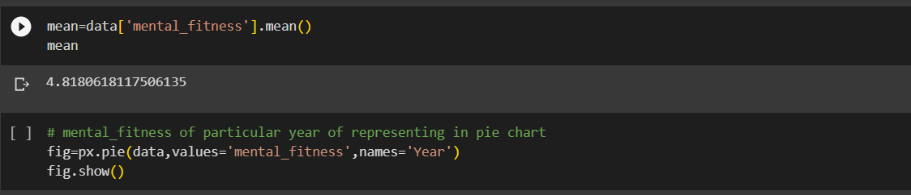
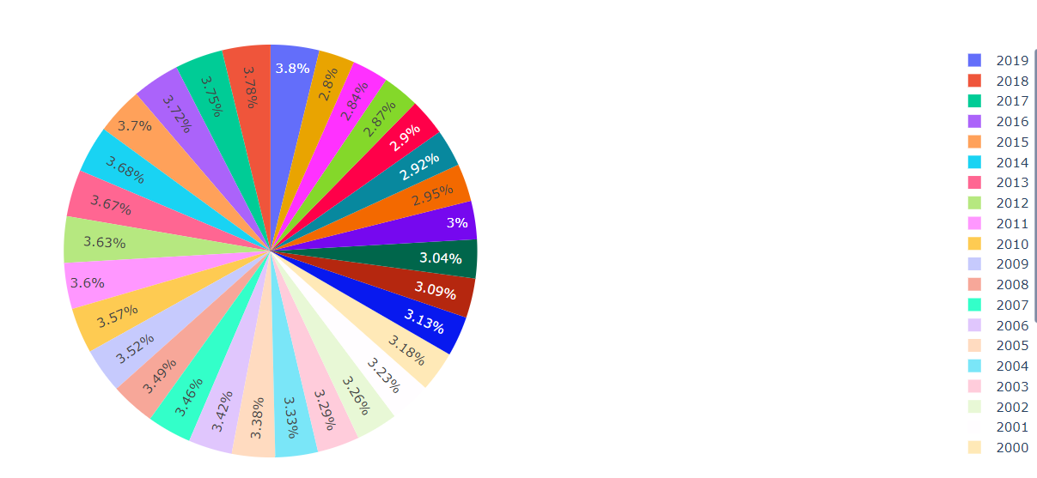
MODELLING

Slide 17
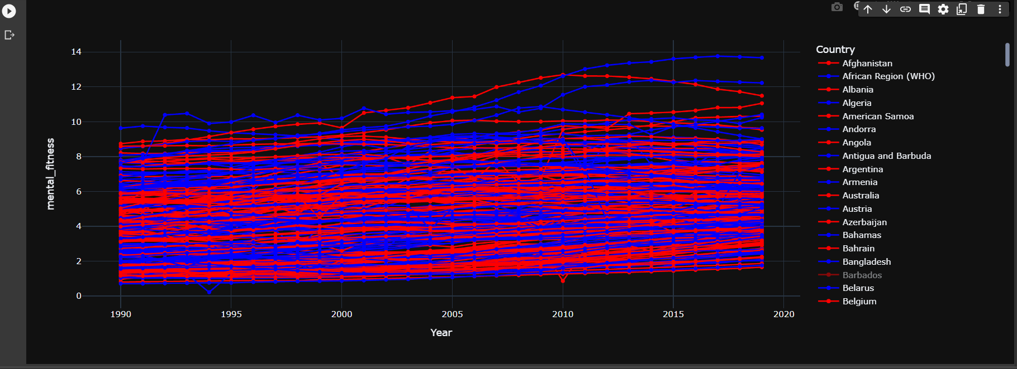
MODELLING

Slide 18
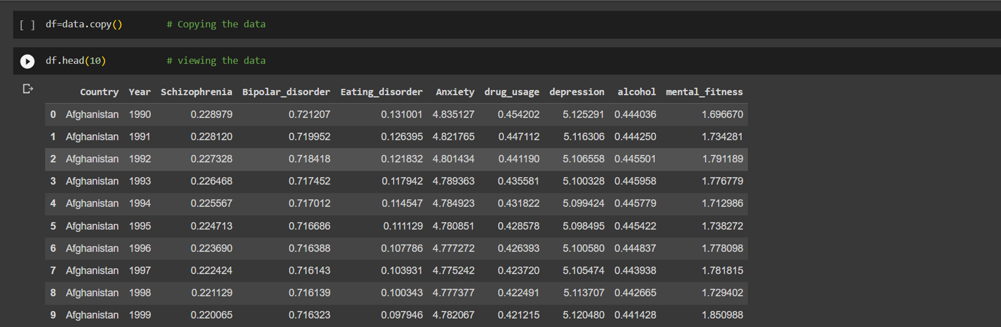

Slide 19
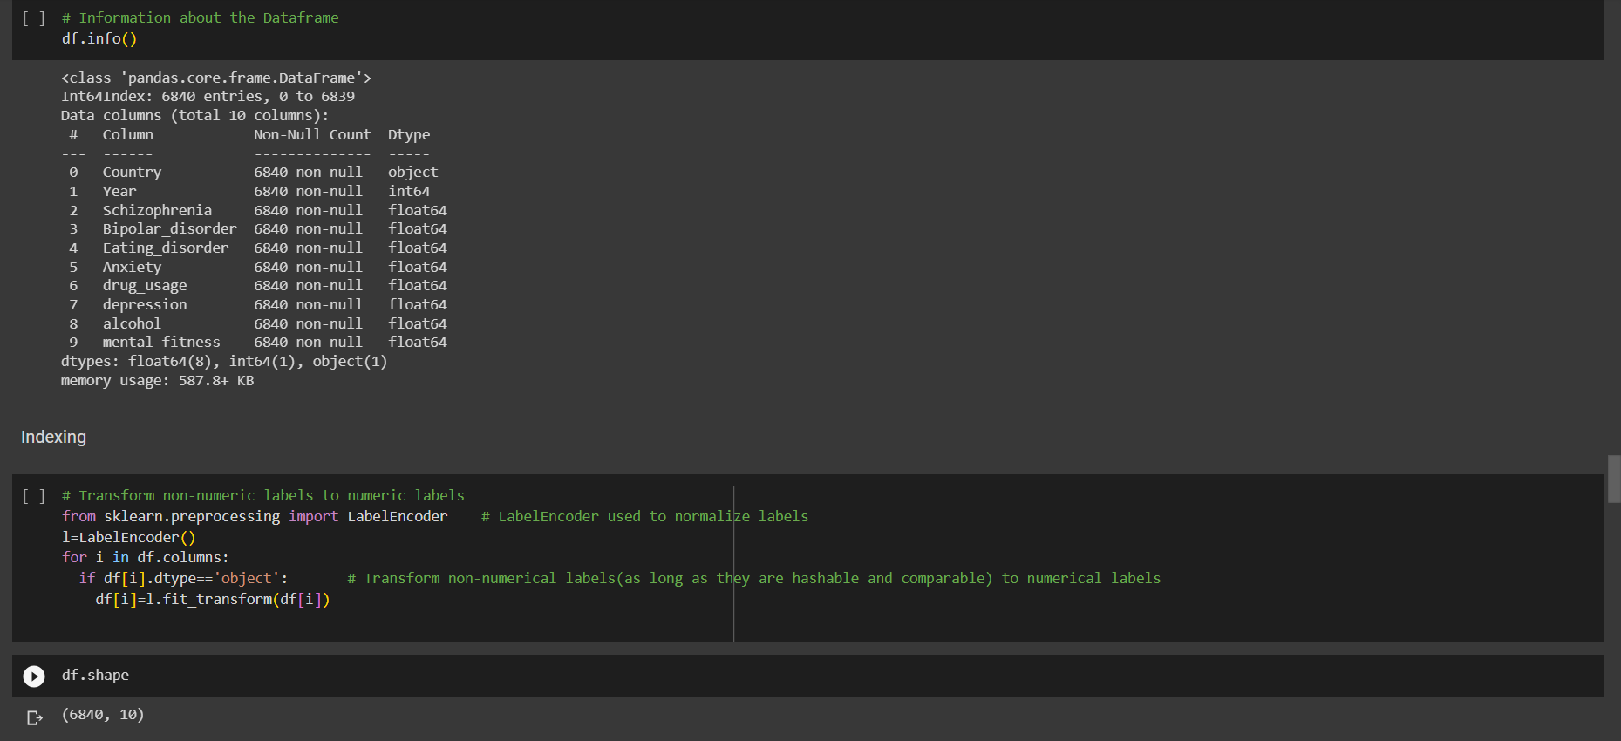
MODELLING

Slide 20
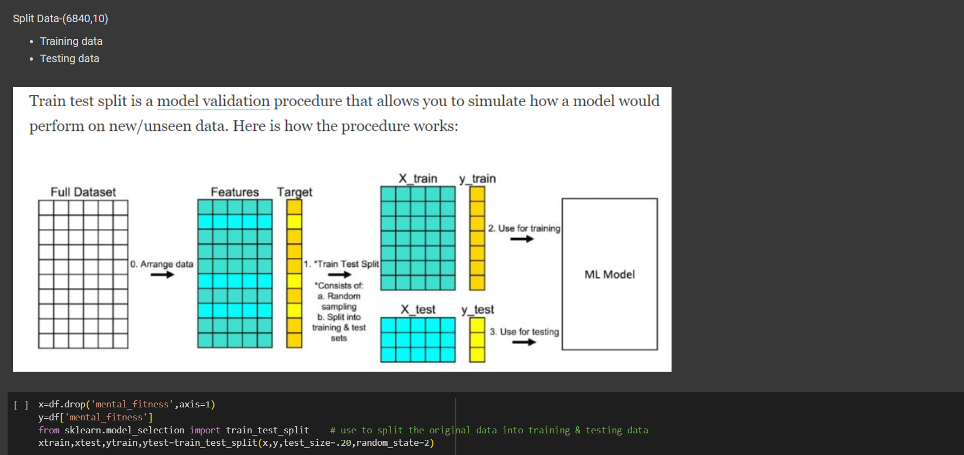
MODELLING

Slide 21
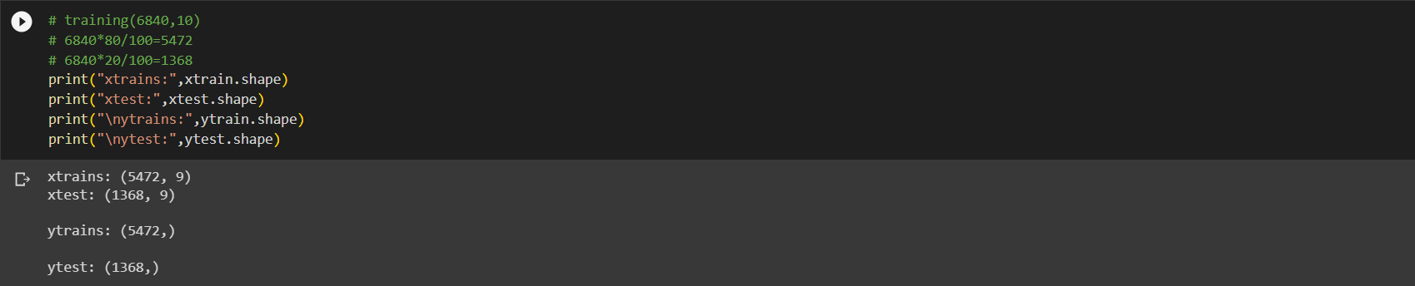
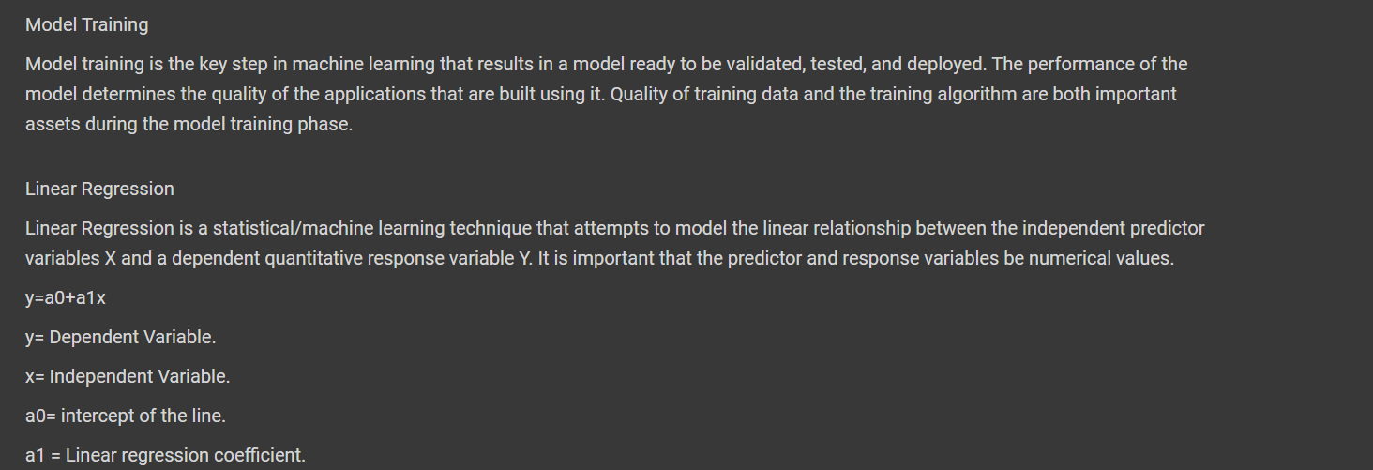

Slide 22
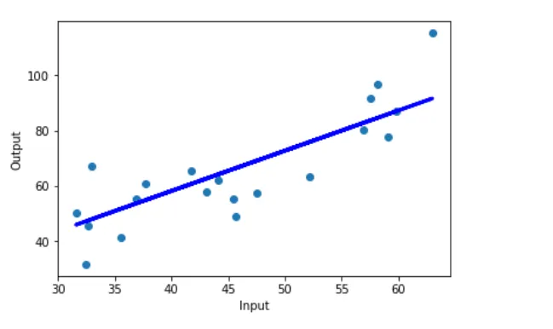

Slide 23
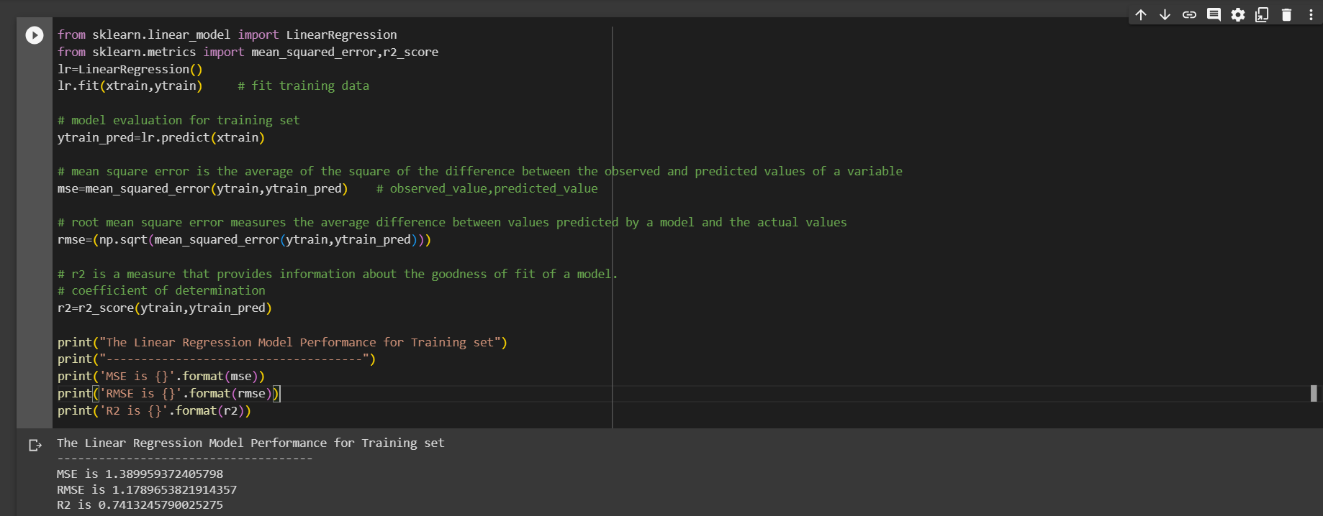
RESULTS

Slide 24
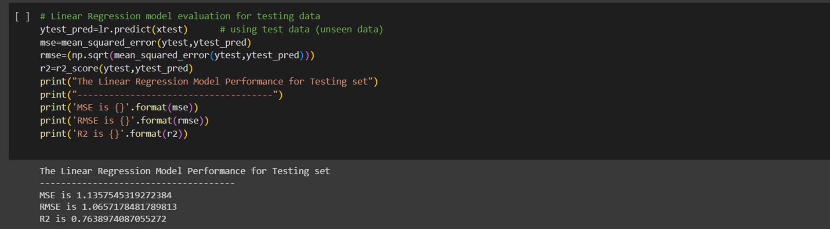

Slide 25
links
https://colab.research.google.com/drive/1x25GIE_hiy-DTYTMgfrv1x9iqkoOJ6ZP?usp=drive_link

